Slide 1
CP3
11 SEP 2026 · CHANGE REQUEST
Specimen Sorter API
Today staff scan a label and click Send-out or Register. The sorter will scan the tube and call LIS for those same actions.
SERVICE
DATE
JIRA
PRESENTER
PRESENTERS
REVIEWERS
lis-crs-spec-ack-svc
11 Sep 2026
TMP-000
Ka
Ka
Tony Chong, CP3 panel
Design status: draft · for briefing
Notes:
Cover is identity only. TMP-000 is the dossier stand-in. Tony Chong reviewed the design note.

Slide 2
BACKGROUND
Staff scans and presses today. The sorter will call LIS
AS-IS
Staff scans and presses
TO-BE
Sorter scans, LIS answers
scan the specimen label
press Send-out or Register
sorter scans for sort and transport
LIS API for send-out or register
On Specimen Acknowledgement
One call, then a bin
One tube, one staff action
Staff screen stays as fallback
Specimen Acknowledgement remains the fallback when the sorter returns Relabel or Failure.
Notes:
As-is is the staff click path. To-be is the sorter calling LIS for the same send-out and registration actions. Checks and packing still sit on the screen today.

Slide 3
EXISTING DESIGN
The Spec Ack screen still owns validation and packing
Action | Front-end | Back-end
Retrieve GCRS | Scan Specimen Label | Calls backend
Send-out | Presses Send-out | Calls backend
Registration | Presses Register Request. Validates. Groups tests, request no., maps ward and doctor | Calls backend
Worksheet | Converts worksheet data | Calls backend to print
PHLC order | None | Calls backend
Notes:
Amber is what moves. Group tests, request no., and ward/doctor mapping sit on registration, not on worksheet. Worksheet has its own convert, then print.

Slide 4
PROPOSED CHANGE
One new POST on the Spec Ack service
!
Same-call status
POST /api/sorter/auto-register
REGISTERED, SEND_OUT, RELABEL, or FAILURE. Soft alerts stay off the body.
{
"usid": "QHSP2500000012",
"sorterId": "KTH-SORTER-01",
"hospital": "QEH",
"hkid": null,
"patientName": null
}
!
Optional identity
hkid and patientName. If sent and they mismatch, Failure.
!
New path, not an overload
usid and sorterId are required. hospital may be omitted when the map has it.
Do not reuse the staff register call. No auth header in v1.
Notes:
Hospital, if sent, must match the map and workbench. Unknown sorterId is Failure. Transport errors stay 500.

Slide 5
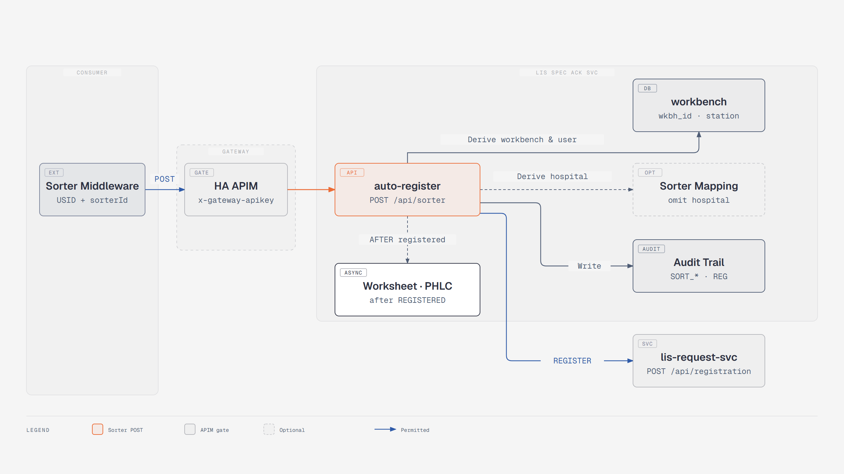
PROPOSED CHANGE
Auto-register calls lis-request-svc to register
Notes:
The sorter POST stays on lis-crs-spec-ack-svc. The register write is lis-request-svc, POST /api/registration. Audit stays on the Spec Ack trail.

Slide 6
PROPOSED CHANGE
Screen logic moves behind that POST
TODAY
On the screen
PROPOSED
On the new API
validate, then convert
group tests, request no.
map ward and doctor
same checks and packing
then existing backend writes
Reuse register, worksheet print, and PHLC
Worksheet convert also runs here
Print and PHLC only after Registered
Then the screen calls register or print
Send-out, Relabel, and Failure print nothing. A late worksheet does not change a status already returned.
Notes:
The next slides walk each Spec Ack action. The API calls the same print and PHLC services Spec Ack uses today, in-process, not by looping back over HTTP.

Slide 7
PROPOSED CHANGE
Sorter id maps to a dedicated user and a workbench
1
2
3
LOE_SPECIMEN_SORTER_MAP
WORKBENCH
LOE_AUDIT_TRAIL
The map row
The workbench row
Audit user and station
Sorter id to LIS user and workbench id. Also hosp, lab, and server name so LAB_DB can open.
Hospital, lab, station name, STAR location, and default printer. Not copied as a second source of truth on the map.
Audit user is the map user. Workstation is the workbench station name. Write SORT_* plus REG and SEND_OUT.
Unknown sorter id is Failure. Do not compare workbench lab to the retrieved test lab.
Notes:
Staff today pick a workbench by PC name or IP. The sorter has no PC login, so the map is the lookup. Printer stays on workbench.

Slide 8
PROPOSED CHANGE
User and workbench come from the sorter id
TODAY
Staff login, then a PC workbench
SORTER POST
sorterId looks up the map
User is the staff LIS login.
Dedicated sorter LIS user from the map. Never the demo retrieve user.
Workbench is selected by PC name or IP.
Staff retrieve GET uses a hard-coded demo user.
Workbench id from the same map row, then hosp, lab, station, location, printer.
Hospital omitted: use map / workbench hosp. Hospital sent must match.
One map row per physical sorter. Seed the user, the workbench, and the map before SIT.
Notes:
If the workbench has no STAR location, that is Failure 4422 later in the checks. The map does not invent a location.

Slide 9
PROPOSED CHANGE
Retrieve GCRS - sorter lookup is USID only
MANUAL
Scan or type, then retrieve
SORTER POST
USID, as the mapped user
Staff enter specimen no., lab no., or order no.
Body needs usid and sorterId. No order-no lookup.
Format, allowed hospital, and check digit run first.
Same format rules. Miss is Failure. Wrong HKID or name is Failure.
Not found stops the screen (1336 / 1337 / 1338 / 1377).
In-process retrieve as the sorter user. APS / BBS / MBS is Failure.
Hospital omitted on the POST comes from the sorter map and workbench.
Notes:
The staff retrieve GET stays. The sorter must not call it. CPS and HMS only. DFT and STAR on those labs still retrieve.

Slide 10
PROPOSED CHANGE
Send-out - the list decides, not a click
MANUAL
Staff press Send-out
SORTER POST
Same list. No flag from the sorter.
Staff choose Send-out after the order is on screen.
Join the test to the send-out list for lab and hospital.
Backend acks Printed or Collected, writes tracking, writes SEND_OUT.
All on the list: existing send-out write, status SEND_OUT.
Local plus send-out on one USID: Failure. No worksheet. No PHLC.
A test is send-out when its cluster code is on the list for that lab and hospital.
The sorter does not send a send-out flag.
Notes:
Call the list the send-out test table if asked. Mixed is Failure so the sorter does not split one tube.

Slide 11
PROPOSED CHANGE
Registration checks - soft logs, hard fails
MANUAL
Popups on the screen
SORTER POST
No dialogue
Soft alerts after retrieve. Staff can continue.
Soft: ALS only. Not on the body. Not Relabel.
Hard checks before Register: mapping, datetime, test, specimen state.
Hard: HTTP 200 and FAILURE, code on the audit remark.
Mixed is Failure. No Relabel checkbox. STAR with no location is 4422.
Mixed local and send-out is a soft alert today.
Ack time is server now. Missing collection date is soft. Do not invent a date.
Notes:
Say the mixed change out loud. Staff can still click through that popup. The sorter cannot split the tube.

Slide 12
PROPOSED CHANGE
Soft alerts - logged, then continue
1
2
3
Missing collection date
Overnight specimen
Valid period / sex-age
Proceed. Do not invent a date.
Same overnight window as Spec Ack. ALS only.
Test validity and valid-period warnings. ALS only.
Notes:
First half of the soft set from the confirmed requirement. Next slide has the rest.

Slide 13
PROPOSED CHANGE
Soft alerts - the rest of the set
4
5
6
Duplicate / A-A-R
Patient tag / private
STAR unbox alert
Duplicate-reason and A-A-R-not-ready. ALS only. AAR stays off.
Private patient and patient-tag alerts. ALS only.
Boxed warning is ALS. No workbench location is Failure 4422, not this card.
BBS blood / category / T&S alerts stay on staff Spec Ack. BBS is out of v1.
Notes:
Mixed is not here. The locked design made mixed a hard Failure.

Slide 14
PROPOSED CHANGE
Hard checks that return Failure
1
2
3
1162-1170, 1090
R12
4422
Unmapped ward / doctor
Datetime
STAR / mixed / empty
Doctor, location, specialty, report dest, or report copy has no LIS id.
Collection before DOB. Ack before collection or request. Ack in the future.
No workbench location. Local plus send-out. Already used, all registered, all deleted, rejected.
Also Failure: missing test dictionary, HKID or name mismatch, APS / BBS / MBS, unknown sorter id.
Notes:
Do not auto-create an unmapped doctor or location. Soft set on the previous two slides is not Failure.

Slide 15
PROPOSED CHANGE
Request test grouping and request no.
MANUAL
Screen groups, then assigns
SORTER POST
Same grouping. No checkbox.
Tests are grouped before Register. Each group needs a request no.
Same Relabel rules, without a user tick.
One group, one specimen, suffix 0, not force: request no. = USID.
USID can be the request no. when the screen says it is eligible.
Else Relabel. No lab request. No invented number. No caller-assigned request no.
Staff can tick Relabel. Multi-group, multi-specimen, suffix not 0, or force: no USID.
Relabel is its own status. Not Failure. Not Registered.
Notes:
Partial DFT remainder is Relabel. DFT still uses Spec Ack register, not the DFT register API.

Slide 16
PROPOSED CHANGE
Ward and doctor mapping
MANUAL
Map, then popup
SORTER POST
Same map. No create.
Doctor, location, specialty, report dest, and report copy come from dictionary.
Same five mappings go onto the packed register call.
Any miss is Failure, same message codes as Spec Ack.
Unmapped codes block Register.
Do not auto-create a doctor or location. Send the tube to staff.
Staff can create a doctor when dictionary allows it.
Do not compare workbench lab to the order test lab.
Notes:
Report destination can follow request location when that Spec Ack option is on. Port the existing rule. Do not invent a new one.

Slide 17
PROPOSED CHANGE
Worksheet printing - all after Registered
MANUAL
Staff print after Register
SORTER POST
Print all, after the HTTP return
Staff can print GCRS, send-out, and SH worksheets after register.
Return REGISTERED first. Then print every worksheet Spec Ack would. No picker.
If more than one worksheet, staff pick.
Send-out, Relabel, and Failure print nothing. No labels.
Labels can also print on the staff path.
Late worksheet is allowed. Print fail is ALS. Status stays Registered.
p95 under 4 seconds is retrieve plus send-out or register. Print is off that clock.
Notes:
Same three staff print services, in-process, no HTTP loopback. Registration only.

Slide 18
PROPOSED CHANGE
PHLC electronic order - after Registered
MANUAL
Screen calls PHLC after register
SORTER POST
Same create. Sorter does not wait.
Spec Ack creates a PHLC order when the lab option is on.
Same PHLC create, in-process, after REGISTERED is already back.
Destination must match the existing PHLC rule.
Staff wait on the screen for that call.
Only when Spec Ack would send. Send-out, Relabel, and Failure skip it.
PHLC fail is ALS. Sorter status stays Registered.
No labels on the sorter path. Worksheet and PHLC never run on Send-out.
Notes:
PHLC is already backend. The change is when it runs. Do not invent a new PHLC contract.

Slide 19
PROMOTION
Seed user, workbench, and map, then deploy
1
2
Create the sorter user
Seed a workbench row
Dedicated LIS user on the audit trail. Not a shared staff login.
One row per sorter: hosp, lab, station name, location, printer.
3
4
Insert the map row
Deploy and open the path
Sorter id, user, and workbench id on loe_specimen_sorter_map.
Deploy lis-crs-spec-ack-svc. NetworkPolicy only. No API key in v1.
Notes:
Pilot CPS and HMS. Relabel and Failure bins go back to staff Spec Ack. Add SORT_* to the Audit Trail filter.

Slide 20
FALLBACK
Stop middleware. Staff Spec Ack is unchanged
1
2
3
Stop middleware
Drop the map table
No history rewrite
Staff clicks still retrieve, send-out, and register.
DROP TABLE loe_specimen_sorter_map on full rollback. Leave or disable the workbench and user.
Do not convert historical requests. Fallback is operational.
Notes:
The staff path is the fallback. Drop only the map table.

Slide 21
OPEN QUESTIONS
Four decisions to ratify before build
01
Leave v1 with NetworkPolicy only, no API key or Hub JWT?
Same isolation as Spec Ack today (D1).
02
Fail the tube when the USID has both local and send-out tests?
Staff Spec Ack only warns (D3).
03
Print worksheets and PHLC only after Registered, after HTTP return?
Send-out prints nothing (D11, D4, D5).
04
Show SORT_* actions on the Audit Trail filter?
Still write REG and SEND_OUT (D6).
Requester already answered D1-D11. This room ratifies.
Notes:
Requester already answered D1-D11. This room is the ratification, not a new design pass.

Slide 22
DISCUSSION
Q&A
Notes:
Likely questions: why a new POST; why hospital can be omitted; why DFT uses the same register path.

Slide 23

NEXT
Target latency
P95 < 4 S
About 20 specimens a minute per lab in v1. Worksheet and PHLC sit after the sorter wait path.
ASSIGN A PRODUCTION JIRA
IMPLEMENT THE POST
SEED SIT
Replace TMP-000. Reference remains SEM20260612.
New API on lis-crs-spec-ack-svc, including the packing the screen does today.
Sorter user, workbench row, and loe_specimen_sorter_map before middleware is pointed at SIT.
TMP-000 lis-crs-spec-ack-svc · Change Request
Notes:
Volume pass mark is about 20 specimens a minute per lab. Print sits after the sorter wait path.

